Slide 1
Power builder 簡單教學
John yeh 2020.11.16

Slide 2
Power builder
Workplace / Application Object
Window Object
Control
PowerScript (if switch for , -> ,
DataBase Painter
DataWidnow Object
Menu
Mdi

Slide 3
Application Object

Slide 4
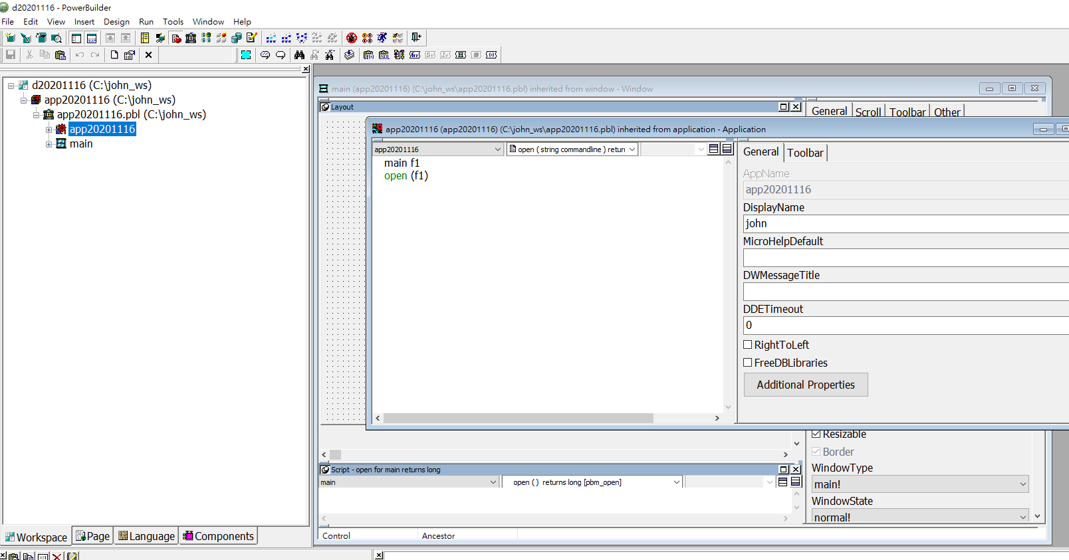

Slide 5
Control

Slide 6
DataBase Painter

Slide 7
PowerScript
Open f1 messageBox(“message”,”dear john”)

Slide 8
Database connect
SQLCA.DBMS = "SYC Adaptive Server Enterprise"
SQLCA.Database = "yist"
SQLCA.LogPass = ""
SQLCA.ServerName = "YMIT27"
SQLCA.LogId = "yuccd"
SQLCA.AutoCommit = False
SQLCA.DBParm = "Release='12.5.1'"

Slide 9
Select/Insert/edit/delete

